Slide 1
Java Workshop 0 – An introduction to Java
This slide is an introduction of an introductory workshop - introduception
Ben Schwarz
*Large parts of this was shamelessly ripped from Java for Dummies by Barry Burd

Slide 2
Before anything:
Please install the following:
Java JDK: (otherwise use OpenJDK) https://www.oracle.com/technetwork/java/javase/downloads/jdk12-downloads-5295953.html
Eclipse: https://www.eclipse.org/downloads/

Slide 3
Why learn java?
Java is a highly useful programming language used in banking, retail, information technology, android, financial services… and most importantly FRC!

Slide 4
Introduction to Programming
Programming languages
Allow programmers to give instructions to a computer that both can understand as well as other people
Most languages share similar concepts
Syntax
Syntax is the structure of how the code is written
Computers can’t infer things, so they like a very strict set of grammar rules. (Syntax).
Compilers:
Compilers turn your Semi-English Code into something a computer can understand
Integrated Development Environments (IDE):
Back in the day, you would need several windows to run code: one to write code, one to run code and another to keep track of all the code you have written.
An IDE combines all of this into one seamless application.
In this course you will use eclipse as your IDE.

Slide 5
Java is:
Concurrent where you can execute many statements instead of sequentially executing it.
Class-based and an object-oriented programming language.
Independent programming language that follows the logic of “Write once, Run anywhere” i.e. the compiled code can run on all platforms which supports java.

Slide 6
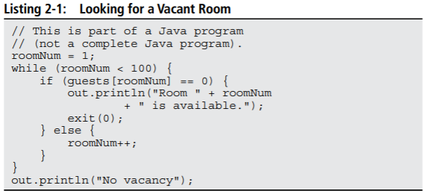
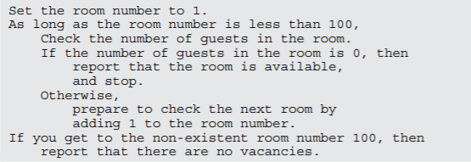
What is a compiler:
A Compiler takes the java source code that you write and makes it into something that a computer can run
Humans can interpret and write Listing 2-1
The code in Listing 2-1 is called Java source code.
Computers aren’t human beings. Computers don’t follow instructions like the Java Source Code in Listing 2-1.

Slide 7
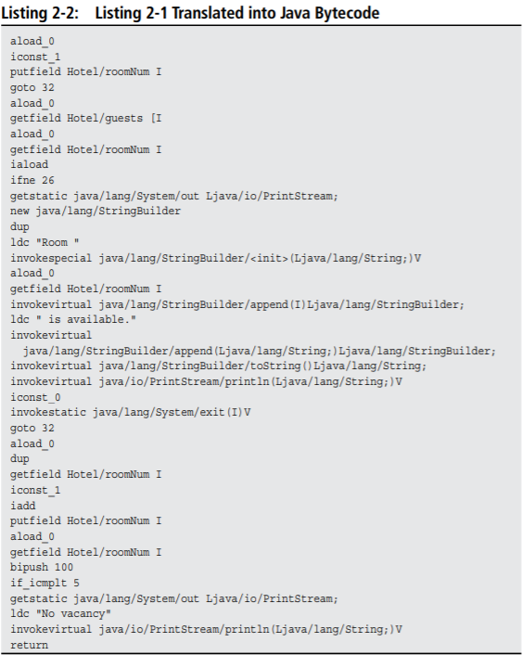
Java Bytecode
Instead of Java Source Code, computers follow cryptic instructions like Listing 2-2.
Listing 2-2 isn’t Java source code instructions, it’s Java bytecode instructions.
When you write a Java program, you write source code instructions (Listing 2-1). After writing the source code, you run a compiler which translates your source code instructions into Java bytecode instructions.
But surprise – computers don’t run bytecode, they run assembly/machine code

Slide 8
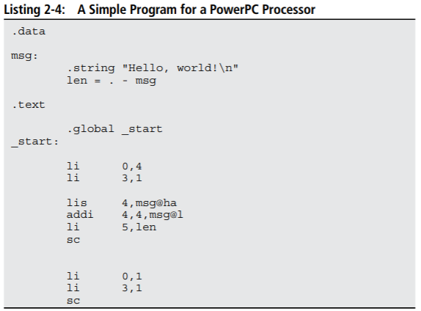
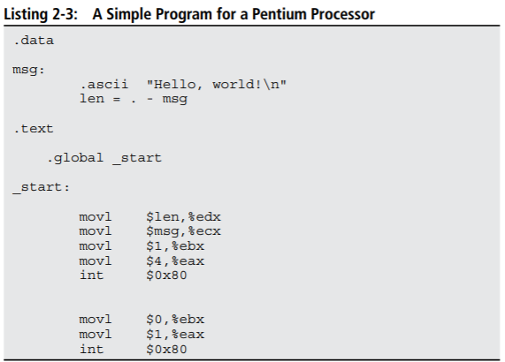
Assembly/Machine Code
Each kind of computer processor has its own set of executable instructions, and each computer operating system uses the processor’s instructions in slightly different ways.
The following two programs write Hello World – one on a Pentium running Linux and the other on a PowerPC processor running Linux
Neither program would work on the other.
*Now imagine running Listing 2-3 on your friend’s Pentium computer running windows. It would scream “Not a valid Win32 application” or “Windows can’t open this file.”

Slide 9
The solution to the chaos
Java bytecode isn’t specific to one kind of processor or to one operating system.
A set of Java bytecode instructions run on any computer.
With Java, you can take a bytecode file that you created with a Windows computer, copy the bytecode to who-knows-what kind of computer, and then run the bytecode with no trouble at all.
How is Java Bytecode so versatile? This universality employed by Java bytecode programs come from the Java Virtual Machine

Slide 10
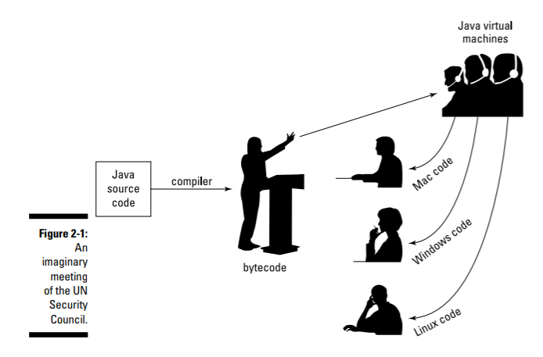
Java Virtual Machine
You’re the Windows representative to the United Nations Security Council. Macintosh to your right and Linux seated to your left. (Naturally you don’t get along with either of these people).
Distinguished representative from Java is at the podium.
The Java representative is speaking in bytecode -> none of you understand bytecode.
You each have an interpreter which translates from bytecode
The interpreter pretends to be the Windows ambassador, and sits through the boring bytecode speech, taking in every word, and processing each word in some way or other.
In the same way, a Windows computer runs its own bytecode-interpreting software. That software is the Java Virtual Machine.
Notes:
You’re the Windows representative to the United Nations Security Council. The Macintosh representative it to your right and Linux seated to your left. (Naturally you don’t get along with either of these people).
Distinguished representative from Java is at the podium.
The Java representative is speaking in bytecode -> none of you understand bytecode.
But each of you has an interpreter. Your interpreter translates from bytecode to Windows while the Java representative speaks. Another interpreter translates from bytecode to Macintosh-ese. And a third interpreter translates bytecode into Linux-speak.
Your interpreter is a virtual ambassador. The interpreter listens to bytecode on your behalf.
The interpreter pretends to be the Windows ambassador, and sits through the boring bytecode speech, taking in every word, and processing each word in some way or other.
You have an interpreter — a virtual ambassador. In the same way, a Windows computer runs its own bytecode-interpreting software. That software is the Java Virtual Machine.

Slide 11
Java Virtual Machine
Is a proxy, an errand boy, a go-between.
The JVM serves as an interpreter between Java’s run-anywhere bytecode and your computer’s own system.
While running, the JVM walks your computer through the execution of bytecode instructions.
The JVM examines your bytecode, and carries out it’s instructions.
The JVM interprets bytecode for your Windows system, your Mac, or your Linux box, or for whatever kind of computer you’re using.

Slide 12
Components of Java
JVM (Java Virtual Machine)
Abstract machine specification that provides a run-time environment in which Java bytecode can be executed.
JRE (Java Runtime Environment)
Refers to a runtime environment in which Java bytecode can be executed.
Implements the JVM
Provides all the class libraries and other support files that JVM uses at runtime.
JDK (Java Development Kit)
Tool necessary to compile, document and package java programs.
The JDK includes the JRE.

Slide 13
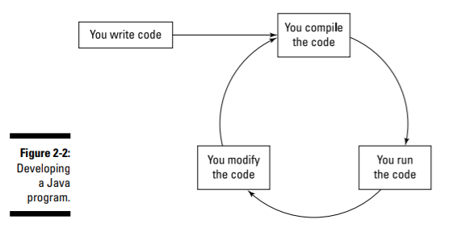
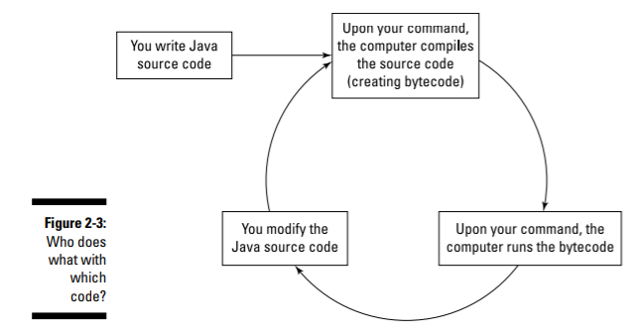
Developing Software

Slide 14
Speaking the Java Language
Picture the entire English language, Maybe you see words, words, words.
Taking a step back, you may see two things:
The language’s grammar
Thousands of expressions, sayings, idioms, and historical names.
The first category (grammar) includes rules like “The verb agrees with the noun in number and person.”
The second category (expressions, sayings, and stuff) includes knowledge like, “Julius Caesar was a famous Roman emperor, so don’t name your son Julius Caesar, unless you want him to get beaten up every day after school.”
The Java programming language has all aspects of a spoken language – words, grammar, commonly used names, stylistic idioms etc…

Slide 15
The Grammar and the common names
Java Language Specification
The Application Programming Interface
This documentation includes rules like, “Always put an open parenthesis after the word for” and “Use an asterisk to multiply two numbers.”
Java’s Application Programming Interface (API) contains thousands of tools that were added to Java after the language’s grammar was defined.
The tools include a routine named pow that can raise 5 to the 10th power and a more razzle-dazzle tool (named Jframe) that displays a window on your computer’s screen

Slide 16
The words in a Java Program
Java programming language has two kinds of words: keywords and identifiers -> however this is somewhat misleading.
Three kinds: Keywords, identifies that ordinary programmers (you and I) create, and identifiers from the API.
The difference between these words is similar to the English language.

Slide 17
“Sam is a person”
Person – like a Java keyword. No matter who uses it, contains the same meaning.
Sam – like a Java identifier, Sam is a name for a particular person.
Words like Sam, Dinswald, and McGillimaroo aren’t prepacked with meaning in the English language.

Slide 18
“Julius Caesar is a person.”
Anyone who says this is probably referring to the ruler of Rome until the Ides of March.
Julius Caesar isn’t hard-wired into the English language, but everyone uses it to refer to the same person.
If English were a programming language, Julius Caesar would be an API identifier.

Slide 19
Words in Categories
Keywords
Identifiers
A word that has it’s own special meaning in the Java programming language.
E.g. if, else, do...
A name for something. The identifier’s meaning can change from one program to another, but some change more than others.
Identifiers created by you and me:
you may name something Prime, and the guy writing code two cubicles down the hall can name something else Prime. That’s okay because Java doesn’t have a predetermined meaning for Prime. In your program, you can make Prime stand for the Federal Reserve’s prime rate. And the guy down the hall can make Prime stand for the “bread, roll, preserves, and prime rib.” A conflict doesn’t arise, because you and your co-worker are writing two different Java programs.
Identifiers from the API (available to anyone who writes a Java Program)
E.g. String, Integer, Jwindow, File.

Slide 20
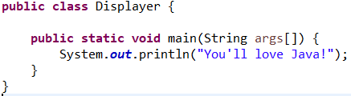
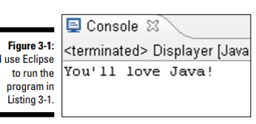
The simplest Java Program.
When you run the code above, the computer displays: You’ll love Java!

Slide 21
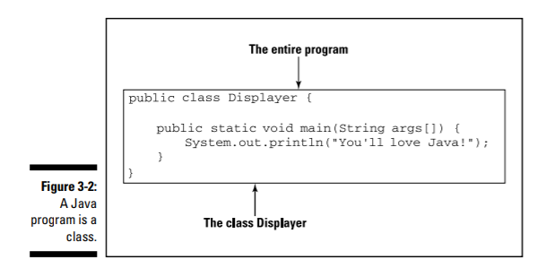
Understanding a Simple Java Program
The Java Class:
Java is object-oriented (ignore this for now) but it means your primary goal is to describe classes and objects.
In Java the entire program is a class.
I chose the name Displayer because the program displays a line of text on the computer.
*In listing 3-1 public and class are Java keywords.
They are the same for everyone, whereas Displayer is
An identifier which I made up – the name for a particular
Class.

Slide 22
The Java method
You’re working as an auto mechanic in an upscale garage.
Your boss – always in a hurry, joins his words and says, “fixThe Alternator on that junkyOldFord.”
Mentally you run through a list of tasks: “Drive the car into the bay, lift the hood…
Three things are going on:
You have a name for the thing you’re supposed to do: fixTheAlternator
In your mind, you have a list of tasks associated with the name fixTheAlternator: “Drive the car into the bay, lift the hood, get a wrench,” and so on.
You have a grumpy boss who’s telling you to do all this work
Using the word method to describe this makes sense. You have a method for doing something with an alternator, your boss calls that method into action, and you respond by doing all the things in the list of instructions you associate with the method.

Slide 23
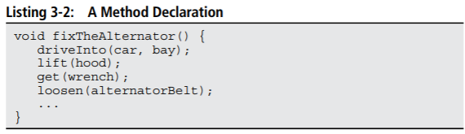

A bit deeper
We will go in depth later in the course but for now:
Somewhere else in my code. I need an instruction to call my fixTheAlternator method into action.

Slide 24
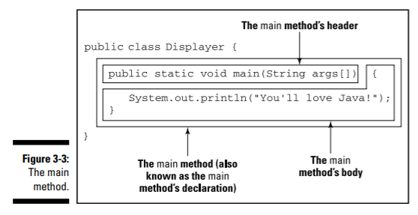
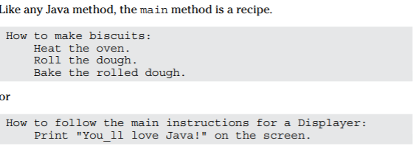
The main method in a program
The bulk of the program in Listing 3-1 contains the declaration of a method named main. (Ignore the other words public, static, void, String and args; those are for later.

Slide 25
Main plays a special role
You never write code that calls a main method into action.
The word main is the name of the method that is called into action automatically when the program begins running.
In the displayer program, the main method’s body has one instruction: print “You’ll love Java!” on the screen.

Slide 26
Hello World!
This is traditionally the first program someone writes.
To test that everything installed correctly, we will all do it together.

Slide 27
Summary
Whew we made it
You should now know what is a:
programming language
Integrated Development Environment
Syntax
Compiler
Java Virtual Machine
Java Runtime Environment
Java Development Kit
Keyword and Identifiers
Method
Main Method
Next workshop we will dive right in and start writing programs.

